Slide 1
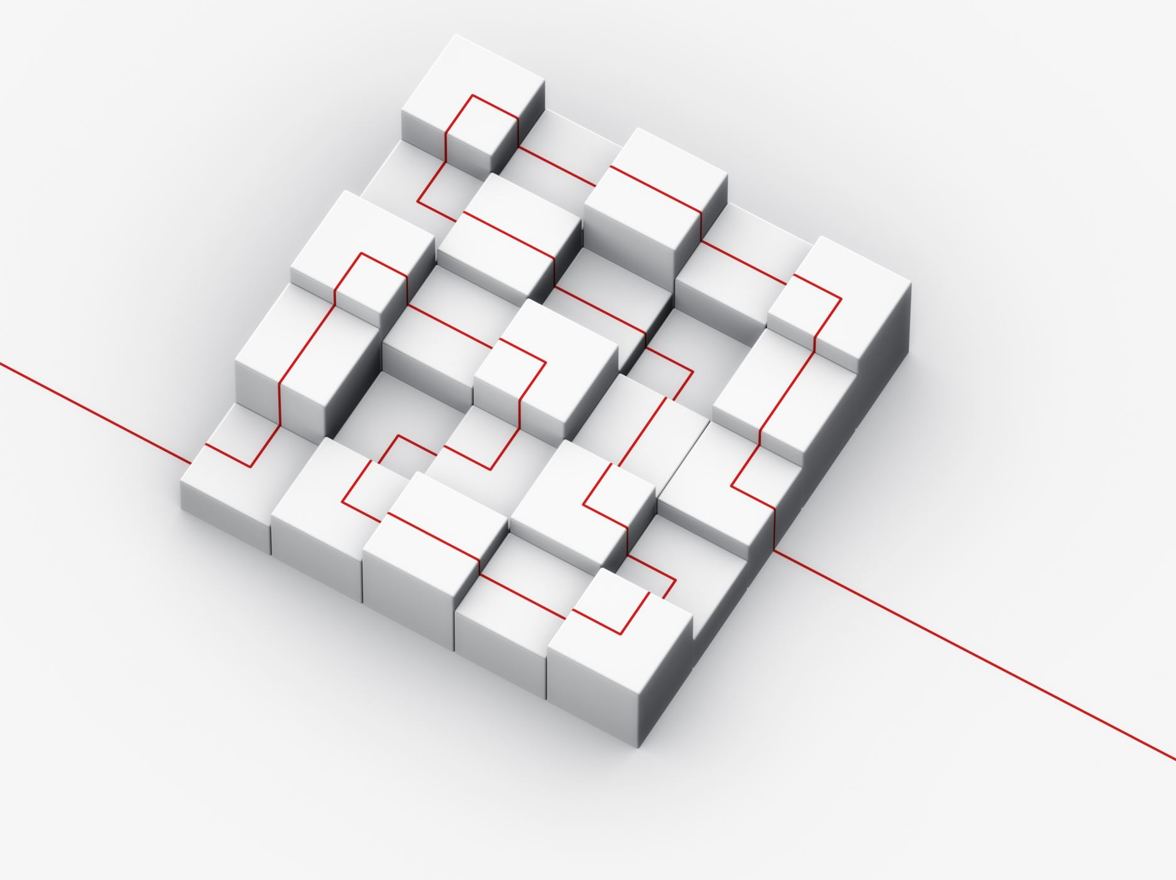
The Five Phases of Design Thinking
Design Thinking is an iterative, human-centered process for creative problem-solving.
The five phases are:
1. Empathize
2. Define
3. Ideate
4. Prototype
5. Test
Notes:
Today, we’re going to walk through the five core phases of Design Thinking. These phases help teams systematically approach complex challenges with empathy and creativity. While they’re often shown as sequential, remember: Design Thinking is iterative. You can—and should—loop back, jump ahead, or repeat stages as needed.

Slide 2

Phase 1: Empathize
Goal: Develop a deep understanding of your users.
Activities:
User interviews
Observations
Empathy mapping
Outcome:
Insight into user needs, behaviors, and motivations.
Notes:
Design begins with empathy. In this phase, the goal is to deeply understand your users’ experiences, needs, and behaviors. Techniques include interviews, shadowing, and immersive observation. We’re not just collecting facts—we’re seeking emotional insight. This understanding becomes the foundation for everything we design.

Slide 3

Phase 2: Define
Goal: Clearly articulate the problem you want to solve.
Activities:
Synthesize findings
Create point-of-view statements
Develop 'How Might We' questions
Outcome:
A user-centered problem statement.
Notes:
After gathering insights, we move to Define. Here, we synthesize our findings to clearly articulate the core problem from the user’s perspective. It’s tempting to rush this, but a well-framed problem unlocks creativity. A great tool here is the “How might we…” question—it reframes challenges into opportunities.

Slide 4
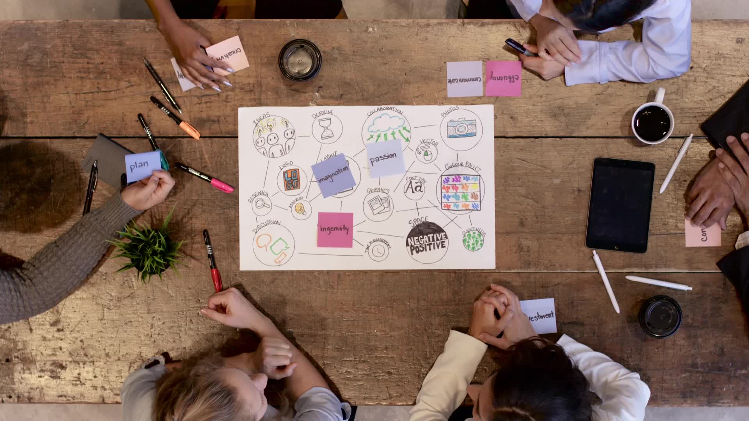
Phase 3: Ideate
Goal: Generate a broad range of creative ideas.
Activities:
Brainstorming
Mind mapping
SCAMPER technique
Outcome:
A pool of innovative and diverse solutions.
Notes:
Now it’s time to generate ideas. The Ideate phase is about volume and variety. We want to go beyond the obvious—no idea is too wild. Techniques like brainstorming, SCAMPER, and mind mapping help get the creative juices flowing. This is also where diverse teams really shine—different perspectives lead to better ideas.

Slide 5
Phase 4: Prototype
Goal: Bring ideas to life in tangible forms.
Activities:
Paper sketches
Wireframes or models
Storyboarding
Outcome:
Testable, low-fidelity versions of solutions.
Notes:
In the Prototype phase, we bring ideas to life—quickly and simply. Think of this as “building to think.” We use sketches, mockups, or simple models to represent key features or workflows. The point isn’t to be perfect—it’s to learn, visualize, and provoke discussion.

Slide 6

Phase 5: Test
Goal: Gather user feedback to refine your solutions.
Activities:
Usability testing
User feedback sessions
Iterative design improvements
Outcome:
Insights to improve and evolve the prototype.
Notes:
Testing lets us learn how users interact with our prototypes. It’s not just about validation—it’s about discovery. Often, we find unexpected issues or opportunities during this stage. We use this feedback to refine, or sometimes revisit earlier stages. Iteration is essential—failure is fuel for learning.

Slide 7
Iterative and Non-Linear Nature
Design Thinking is not a strict sequence.
Teams may loop between stages as needed—ideating again after testing or revisiting research after prototyping.
Flexibility fuels innovation.
Notes:
A key mindset shift: Design Thinking isn’t a straight line. It’s a cycle. You may ideate again after testing or redefine your problem after prototyping. That flexibility allows you to respond to new insights and ensure the final solution truly meets user needs.

Slide 8
Summary of the Five Phases
1. Empathize – Understand your users
2. Define – Frame the problem
3. Ideate – Explore possible solutions
4. Prototype – Build to think
5. Test – Learn and refine
All grounded in empathy and iteration.
Notes:
To recap:
Empathize to understand your users
Define the real problem
Ideate to explore possible solutions
Prototype to bring your ideas to life
Test to learn what works
Together, these phases create a powerful framework for human-centered problem-solving.

Slide 9

Thank You
Design Thinking transforms how we solve problems.
Put people first. Embrace iteration. Build better solutions.
Notes:
Thank you for exploring the Design Thinking process with me. It’s not about getting it “right” the first time—it’s about staying curious, being user-focused, and improving through iteration. I encourage you to try applying these phases to a challenge in your own organization—and see what opens up.

